Slide 1
1st Norwegian workshop on NeuroAI
A strategic opportunity for Norway and Europe
Stefano Nichele, HiØ
Solve Sæbø, NMBU
Klas Pettersen, UiO
Mikkel Lepperød, Simula

Slide 2
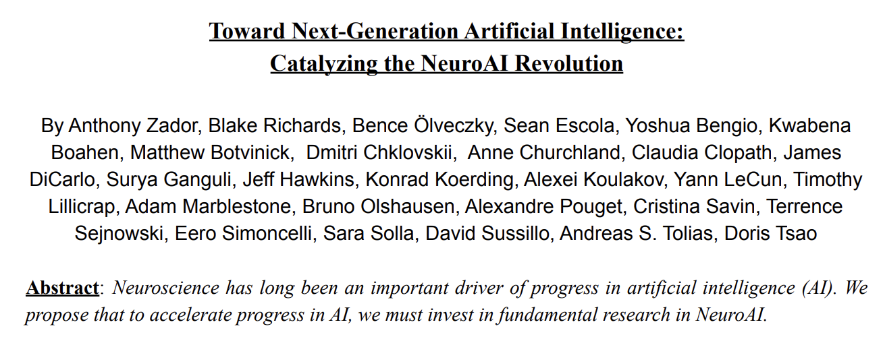
Our inspiration:

Slide 3
“… a better understanding of neural computation will reveal basic ingredients of intelligence and catalyze the next revolution in AI, eventually leading to artificial agents with capabilities that match and perhaps even surpass those of humans.
We believe it is the right time for a large-scale effort to identify and understand the principles of biological intelligence, and abstract those for application in computer and robotic systems.”

Slide 4
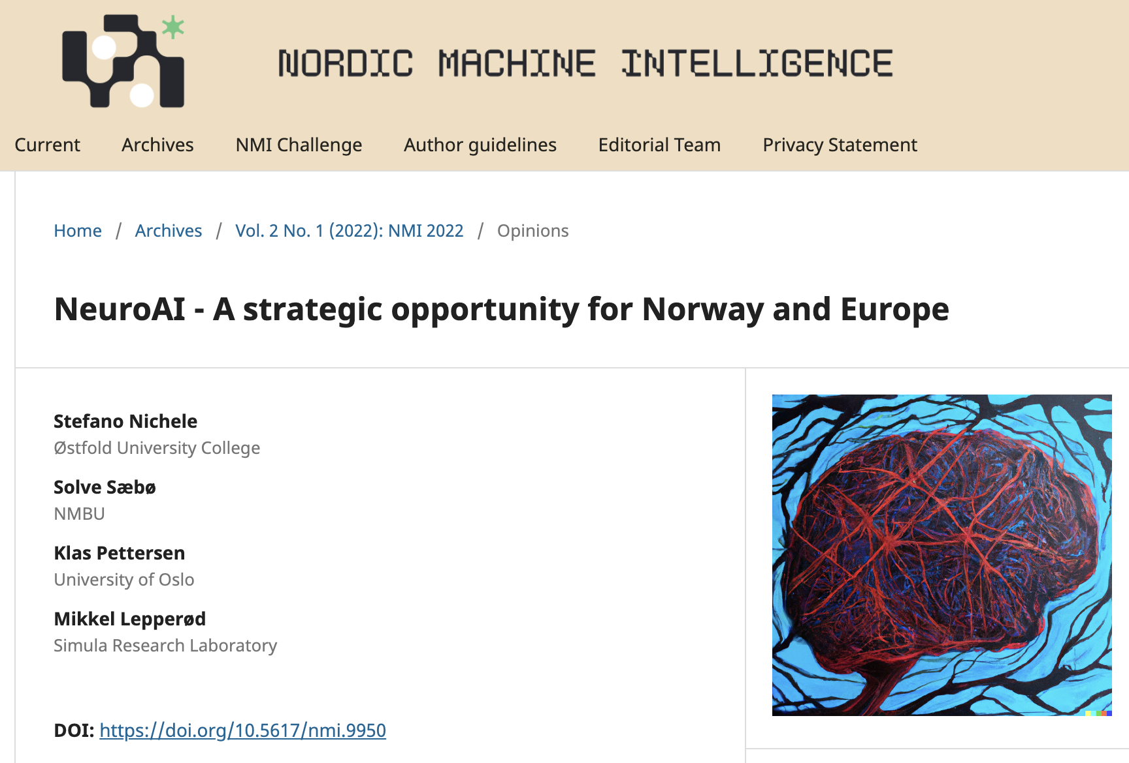
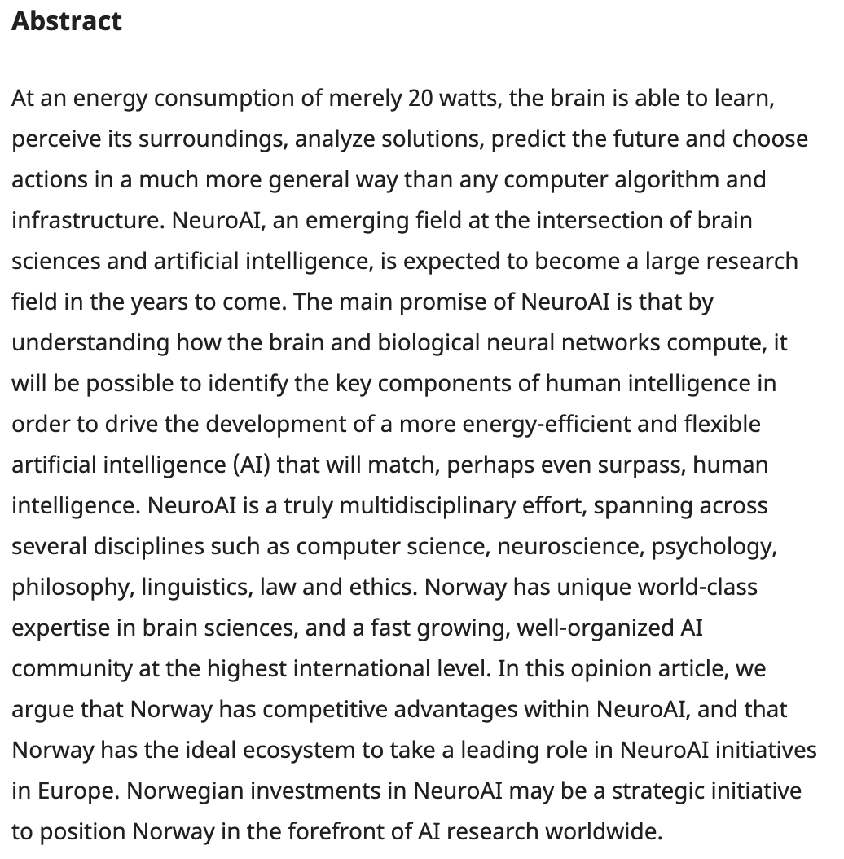

Slide 5
How brain sciences inspired AI
Norwegian strengths and traditions in NeuroAI
Norwegian ongoing activities in NeuroAI
The path forward

Slide 6
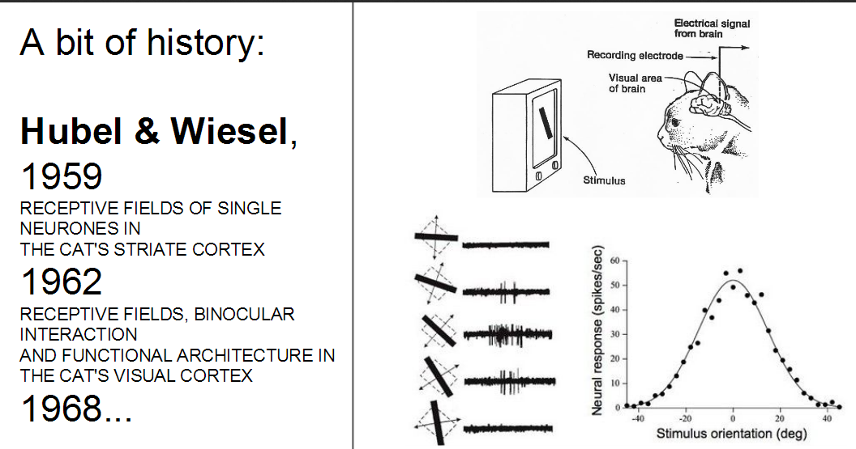
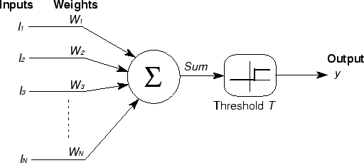
How brain sciences inspired AI
The “attention mechansm”
The “replay mechanism”
…

Slide 7
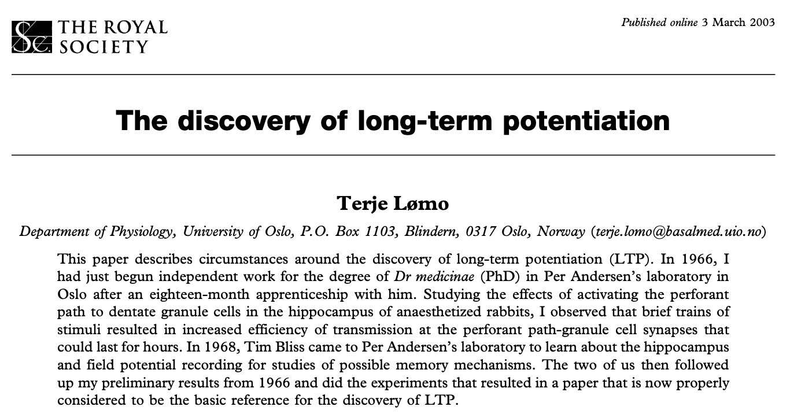
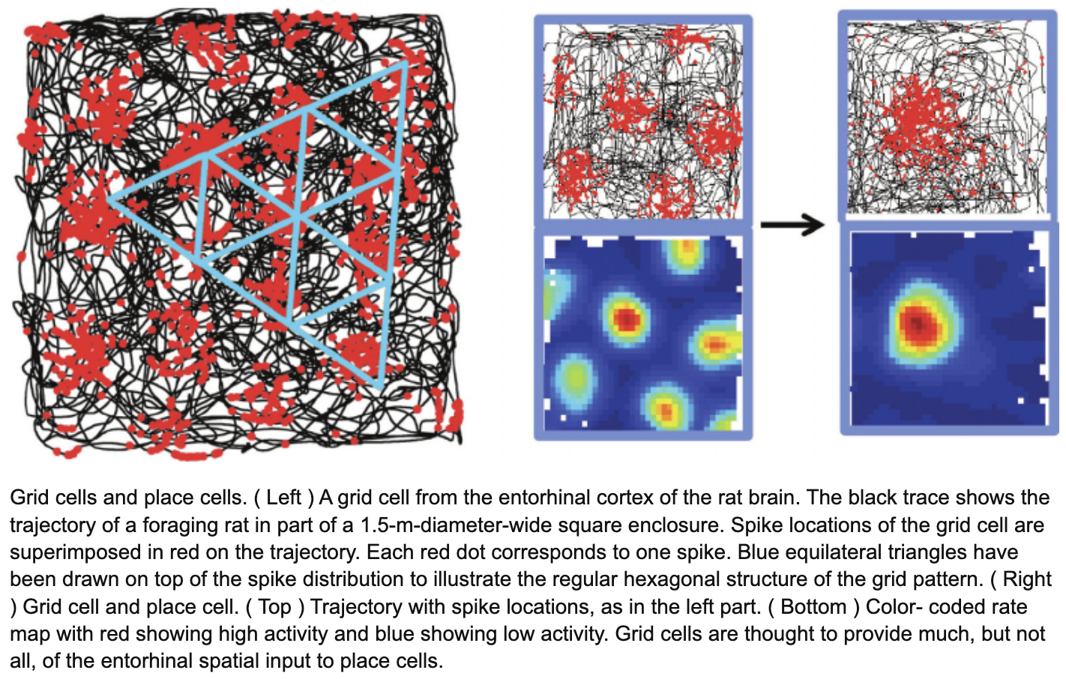

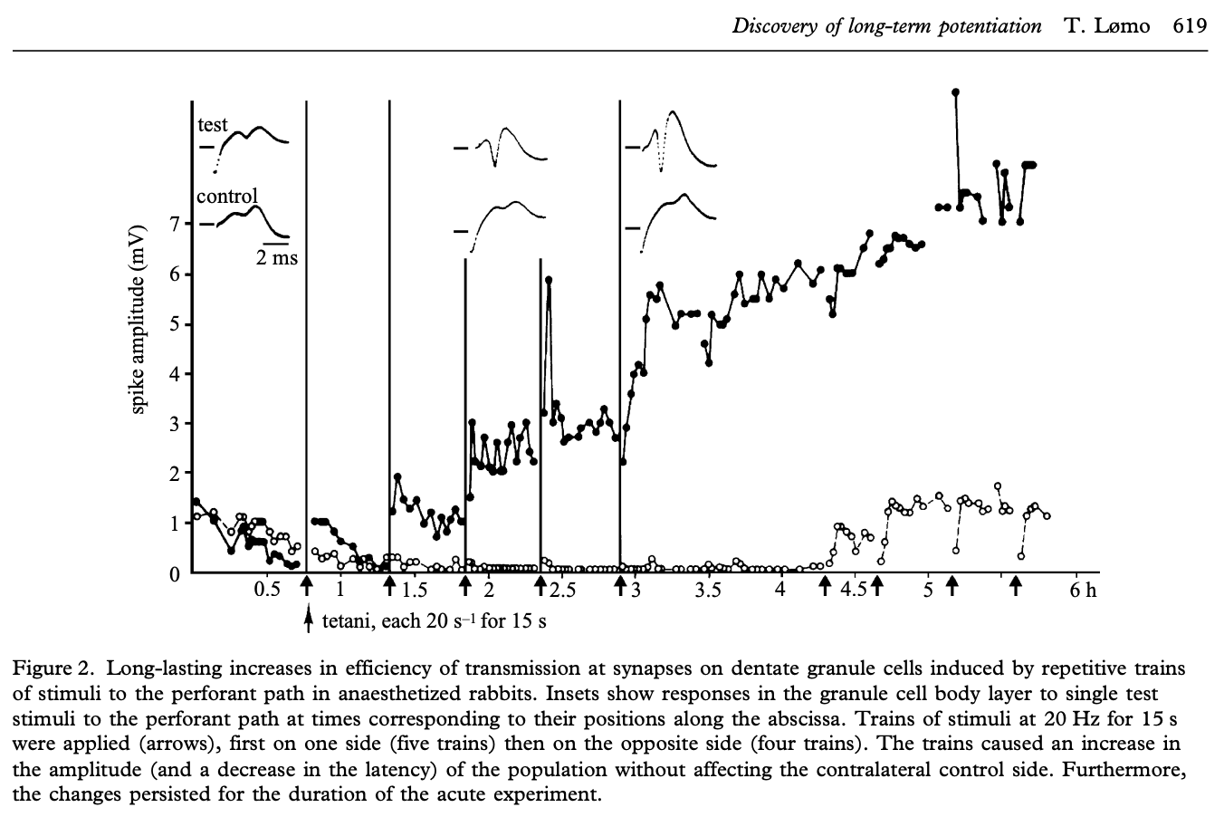
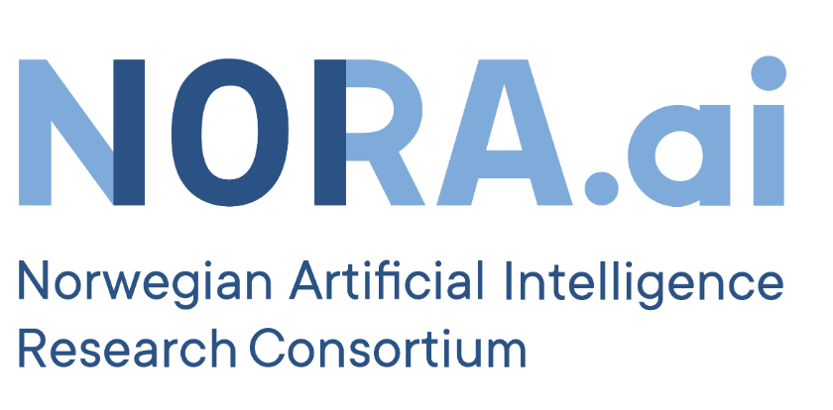

Norwegian strengths and traditions in NeuroAI

Slide 8
Norwegian ongoing activities in NeuroAI
(incomplete list, sorry)
Centre for Algorithms in the Cortex (M.B. Moser, E. Moser, B. Foss - NTNU)
bioAI (M. Lepperød, A.M. Sørensen, M. Fyhn – Simula/UiO)
Socrates (G. Tufte, I. Sandvig, A. Sandvig – NTNU, S. Nichele – HiØ/OsloMet)
DeepCA (S. Nichele – HiØ/OsloMet, I. Sandvig, A. Sandvig - NTNU)
Human Brain Project team (G. Einevoll, H.E. Plesser – NMBU)
PIRC (J. Tørresen – UiO)
...
...
...

Slide 9
The path forward
“…call for a national workshop on NeuroAI … to bring together the NeuroAI researchers in Norway and coordinate the way forward in research and education.”
Long-term plan for research and higher education 2019–2028 — Meld.St. 4 (2018–2019), the Research Council of Norway should prioritize funding for artificial intelligence and neurotechnology. We suggest supporting even further the combination of the two
establish strong partnerships with other European research communities on the forefront of NeuroAI
a national NeuroAI-community should be based on broad and interdisciplinary collaboration across many subject fields (AI, neuroscience, statistics, mathematics, cognitive psychology, philosophy, law, and more)
With strong existing and historic research communities within central subject areas, Norway should have a particular obligation to take the lead in NeuroAI, with the aim of developing the future human-level AI within ethical and sustainable frames
Today’s discussion!

